Slide 1
Large-scale Graph Mining with Spark
What I learned from mapping >15 million sites
Win Suen
PyGotham 2018

Slide 2
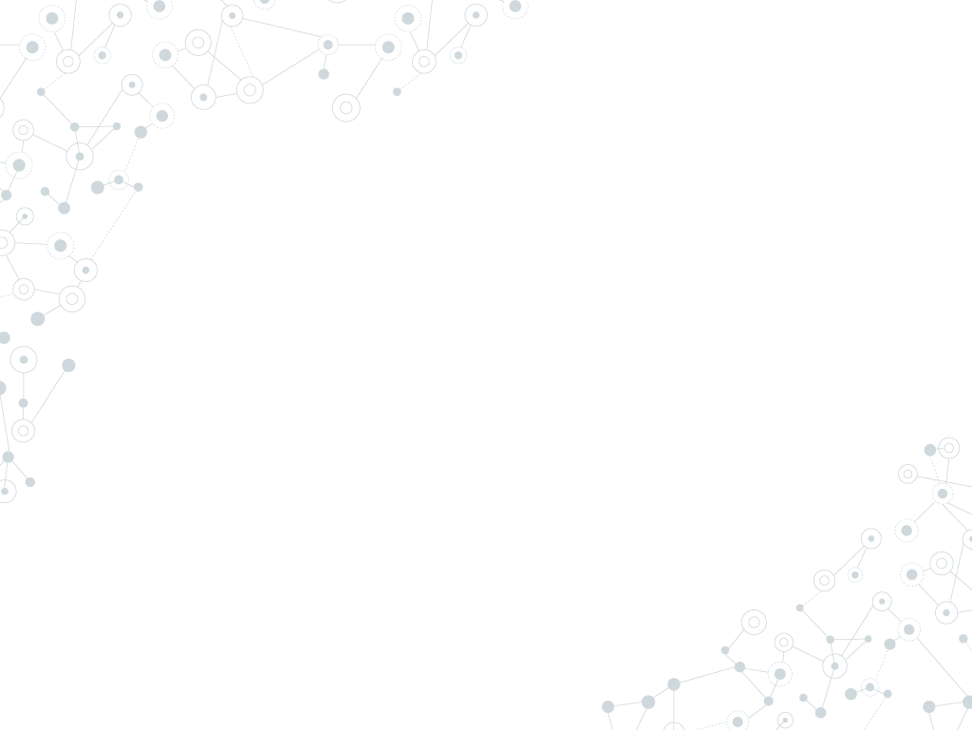

Hello!
I am Win Suen
Data Scientist @ AppNexus (now Xandr).
Avid hiker.
Reader of books and papers.

Slide 3
Agenda
Why?
Labelled data is not always available. Graphs can help.
How?
Unsupervised clustering (finding groups of similar objects from underlying graph structure).
What?
Detect communities in large web graph.
Discussion

Slide 4
Graphs 101
Undirected Graph
Directed Graph

Slide 5
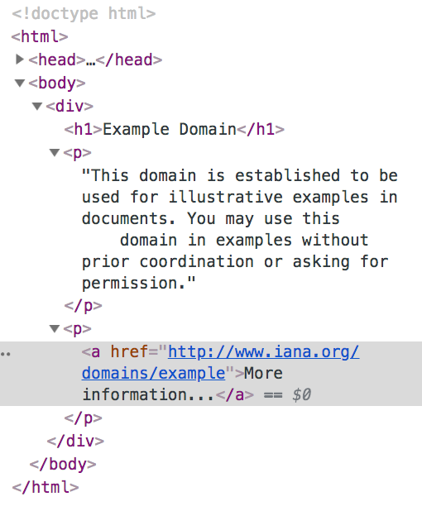
My research: Web graphs
Parent node: example.com
(directed edge)
Child node: iana.org

Slide 6
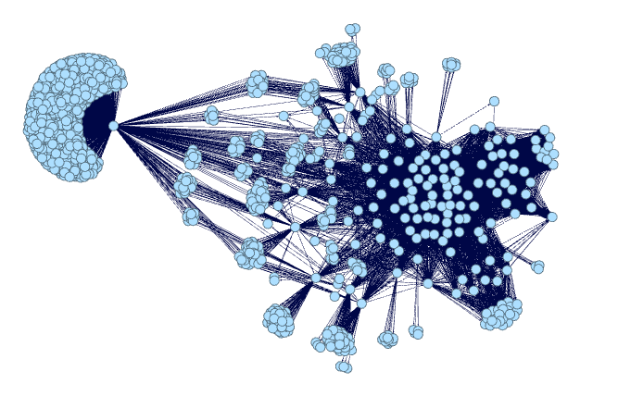
Web graphs: substructures
Subpage structure of a news site, generated by me using Gephi.

Slide 7
Web graphs encode information about:
Communities
Content
Traffic

Slide 8
1.
Why graphs?

Slide 9
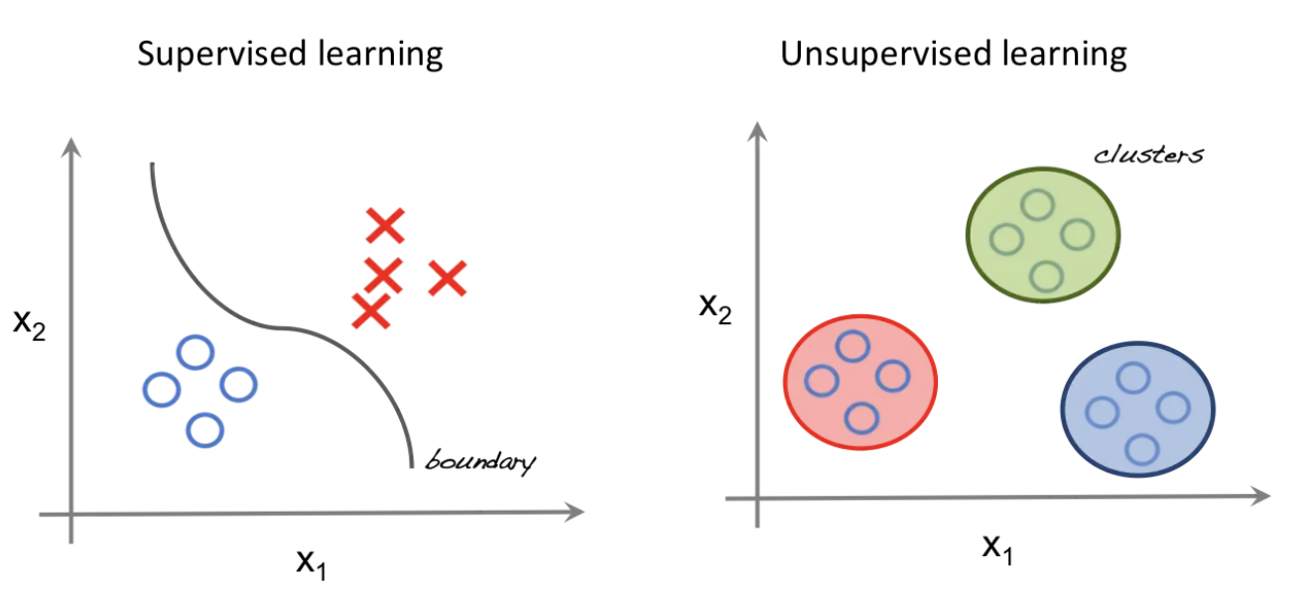
Look, ma! No labels!
http://beta.cambridgespark.com/courses/jpm/01-module.html

Slide 10
Why unsupervised learning?
Data isn’t free.
Labels can be costly.
We may not know how many classes of things we are looking for.

Slide 11
How to do this with graphs? → Community detection!
Community
substructure of a graph where nodes within structure are more densely connected to each other than nodes outside the substructure.
Think of this as like a cluster!

Slide 12
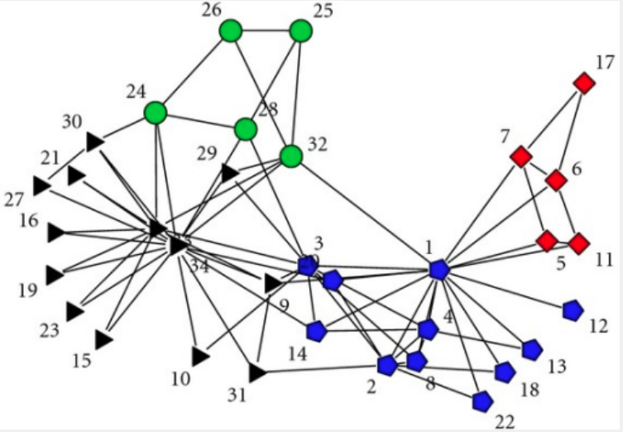
Communities
Zachary karate club dataset -- KONECT, April 2017.

Slide 13
Assumptions
Edges are correlated, not random!
Why?

Slide 14
Assumptions
Edges are correlated, not random!
Why?
Influence: “all my friends are doing it!”

Slide 15
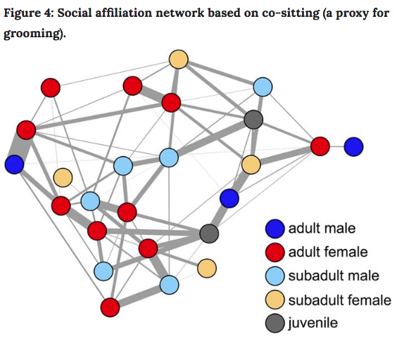
Influence
Farine, Damien R., et al. "Both nearest neighbours and long-term affiliates predict individual locations during collective movement in wild baboons." Scientific reports 6 (2016): 27704

Slide 16
Assumptions
Edges are correlated, not random!
Why?
Influence: “all my friends are doing it!”
Homophily: “birds of a feather, flock together” (aka assortative mixing).

Slide 17
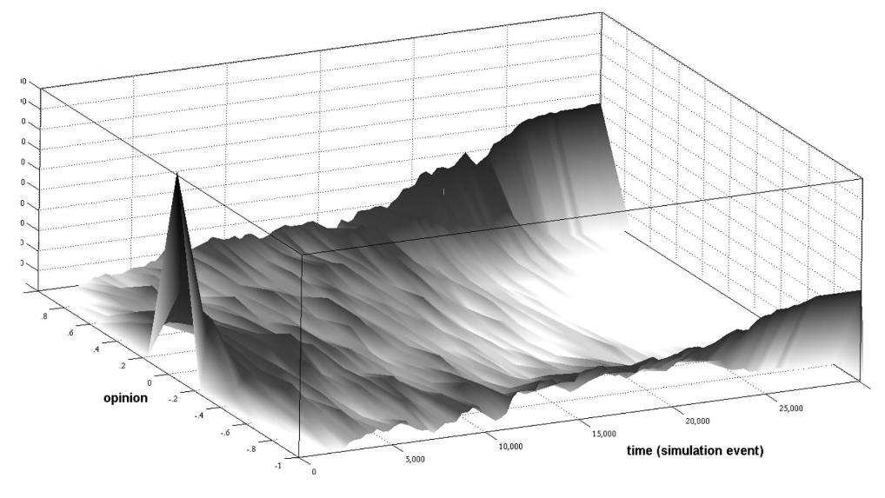
Homophily
Polarization over time
Garimella, Morales, et al, KDD’18.

Slide 18
2.
Graph Mining in Action

Slide 19
3. What

Slide 20
What I did
Clean Common Crawl dataset. Sample files, write custom parser for warc files, extract links from html.
Load graph into Graphframes.
Filter, clean, repeat. Do this, a lot.
Try to detect communities.

Slide 21
What I‘ll talk about
Clean Common Crawl dataset. Sample files, write custom parser for warc files, extract links from html.
Load graph into Graphframes.
Filter, clean, repeat. Do this, a lot.
Try to detect communities.

Slide 22
Graph Libraries
Tool | Graph size | is_python? | Visualization?
networkx | Single machine. | Yes. | Yes.
Gephi | Single machine. | No. | Yes.
Spark GraphFrames or GraphX | Multiple machines. | Yes. | Yes, plug in other libraries.
Apache Giraph | Multiple machines. | No. | No.
Neo4j | Multiple machines. | No. | Yes.
Bespoke solutions (here be dragons) | Many more machines. | ? | ?

Slide 23
Why choose GraphFrames?
Processes data too large to fit on single machine.
Provides parallelism in processing.
Has some fault tolerance.
Integrates nicely with other python packages.

Slide 24
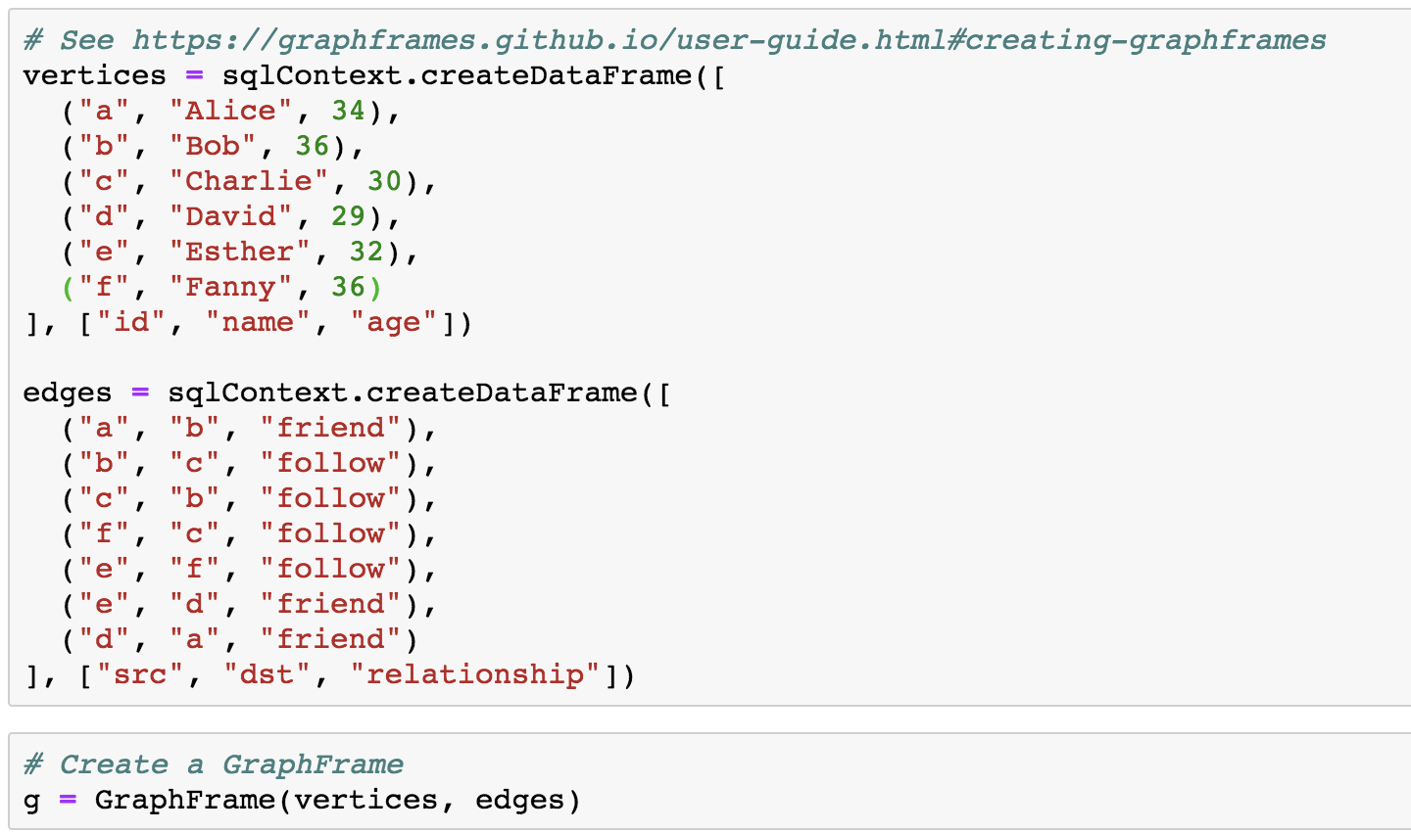
Create GraphFrame

Slide 25
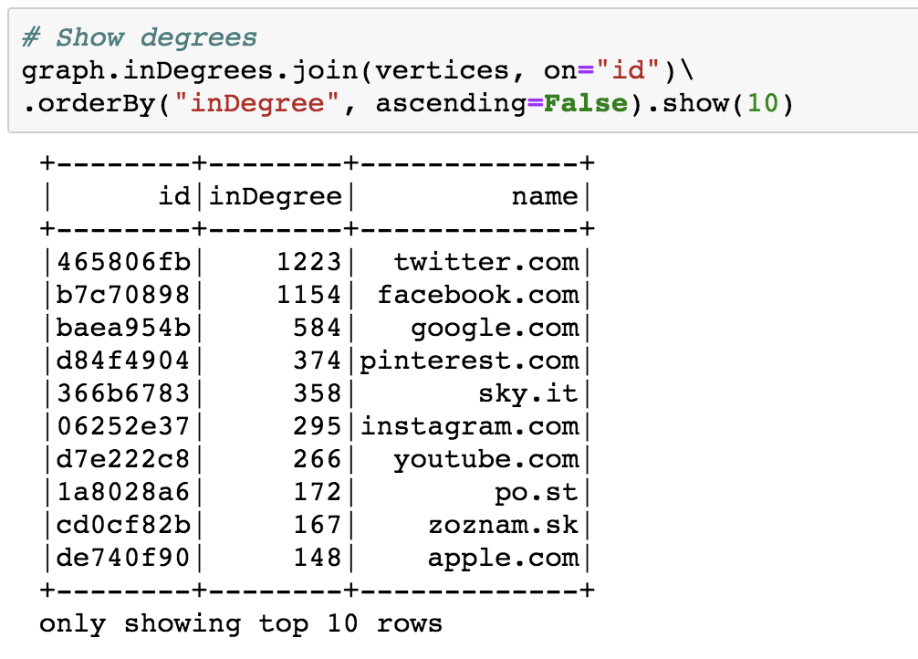
See top nodes

Slide 26
Advantages of Label Propagation Algorithm (LPA)
Labelled data is not required.
External parameter setting is nice, but not strictly necessary.
Runs in near linear time.
Interpretability.
Raghavan, Usha Nandini, Réka Albert, and Soundar Kumara. "Near linear time algorithm to detect community structures in large-scale networks." Physical review E 76.3 (2007): 036106.

Slide 27
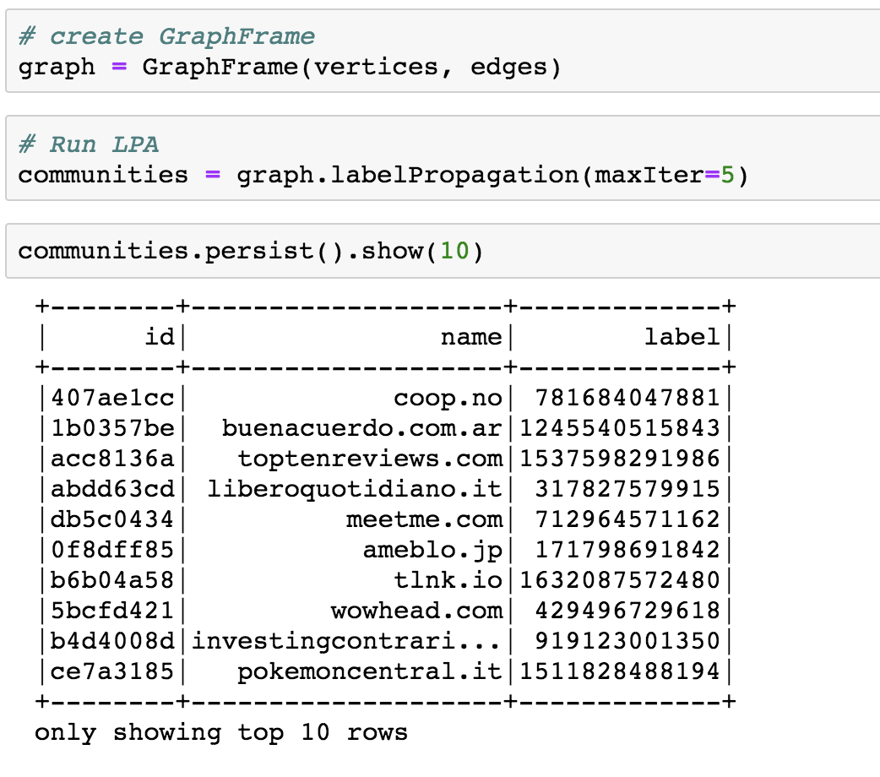
Run LPA

Slide 28
4. Discussion

Slide 29
> 15 million
4,782
3,573 sites
That’s a lot of nodes. Filter, clean, repeat.
Communities detected
Size of largest community

Slide 30
LPA converges around 5 iterations for sampled Common Crawl data.

Slide 31
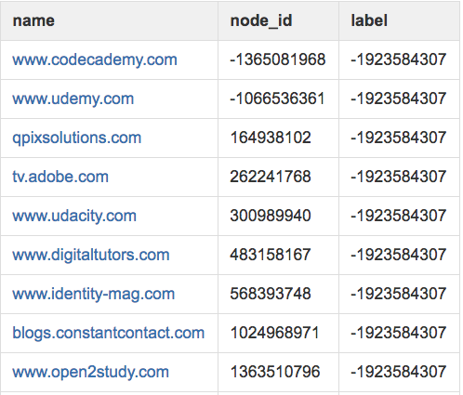
Community: online learning
Mixed community of online learning sites, sites that link to these sites.

Slide 32
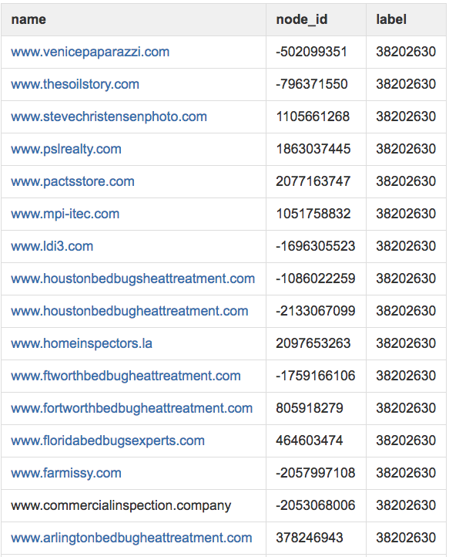
Community: bedbugs
Cookie cutter bedbug sites and sites with similar content resources.

Slide 33
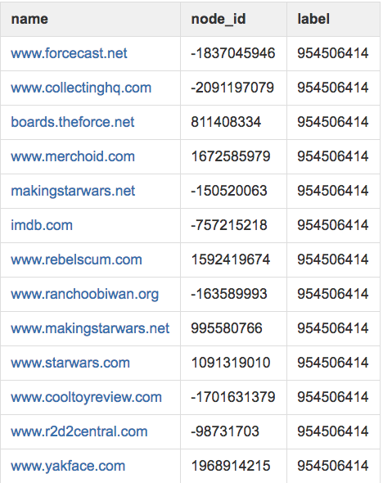
Community: fandoms
Sites related to Star Wars memorabilia.

Slide 34
Applications
Predicting class labels with no previous data.
Recommender for similar sites.
High-level groupings for audience segmentations, classification.
Anomaly detection.
Part of semi-supervised ensemble.

Slide 35
Future Research Ideas
Layer in edge attributes (link types, degree, external metadata, etc).
Monitor nodes of high centrality.
Observe how web graphs change over time.

Slide 36
Why do I love graphs?
Graphs encode valuable, implicit information.
Useful for unsupervised learning and grouping similar objects.
Graphs are fascinating!
Graphs as problem-solving framework.

Slide 37
Obligatory Summary Slide
Graphs very powerful for semi- and unsupervised problems.
Community detection to group objects with graph structure.
How-to, limitations, results.

Slide 38
The tip of the iceberg is what I talked about
Didn’t talk about:
Data parsing
Inconclusive results
Trials and many, many errors ☺
See my Medium post (forthcoming) for more gory detail.

Slide 39
Thanks!
Find me at:
wsuen13@gmail.com
Github:
Medium:

